Slide 1

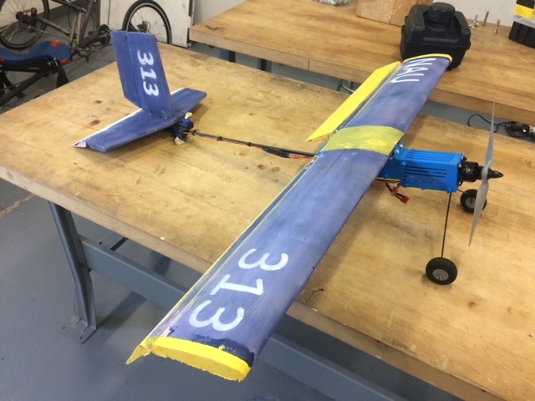
Team Aeolus #313
Yaqoub Almounes
John Cowan
Josh Gomez
Michael Medulla
Mohammad Qasem

Slide 2
Micro Class Requirements
Rules & Objectives
10 lb weight limit
Container with 6” cross section
Payload bay, 1.5” X 1.5” X 5” dimensions
Highest payload fraction
Electronic Propulsion
11.1 V maximum motor power
2200 mA maximum battery power

Slide 3
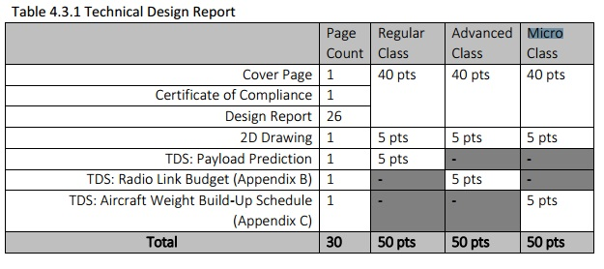
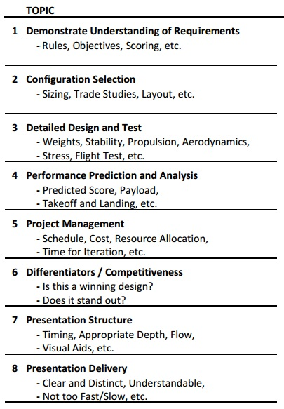
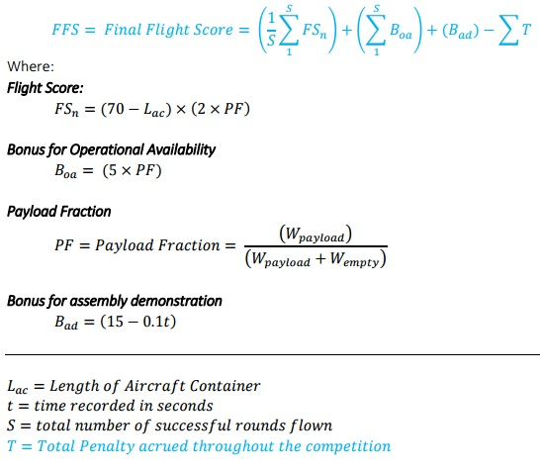
Micro Class Requirements
Scoring [1]
Design Report
Oral Presentation
Flight

Slide 4
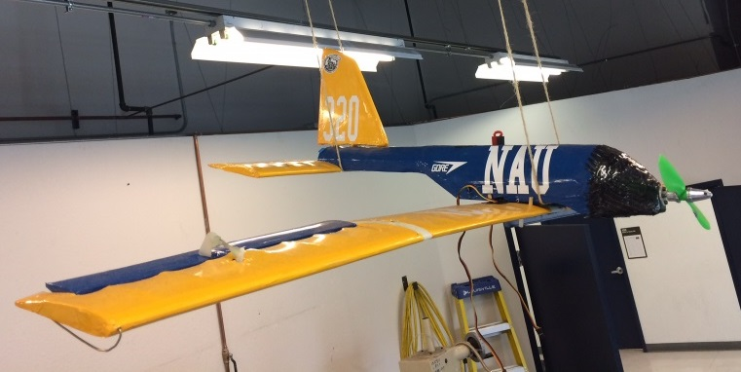
Previous NAU design
IMPROVEMENTS:
  1) Increase Chord Length (Wing and Horizontal Stabilizer)
  2) Wings above fuselage
  3) Decrease body size
  4) Landing Gear

Slide 5
Trade Studies
Wing
Horizontal Stabilizer
Cockpit
Propeller
10” length, 5° pitch
11” length, 5° pitch
12” length, 6° pitch
Criteria:
Lift
Weight
Manufacturability
6” cross-section
Criteria:
Lift
Aerodynamics
Manufacturability
Weight
Criteria:
Drag
Weight
Manufacturability
Payload Bay
Criteria:
Thrust
Quantity
Weight

Slide 6
Sizing
2D Drawing w/ dimensions

Slide 7
Design Challenges
University requirements drastically different from SAE requirements
  1) Report requirements
  2) Manufacturing deadlines
$500 manufacturing budget
Challenges that we faced (schedule, budget limit, manufacturing tools we didn’t have, etc.)

Slide 8
Manufacturing
Talk about overall manufacturing
Tools used (NAU Machine Shop, library 3D printing, etc.)

Slide 9
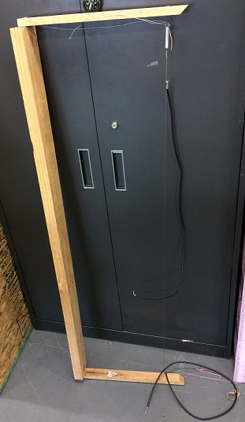
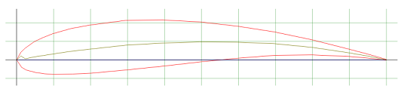
Manufacturing (Wings)
GOE 430 airfoil optimizes lift
42” wingspan, 8” chord length gives AR of 5.25
Hot wire cutter used to create wings
Duplicate wings in case of failure
NACA graph here
Hot Wire Foam Cutter
GOE 430 Airfoil [2]

Slide 10
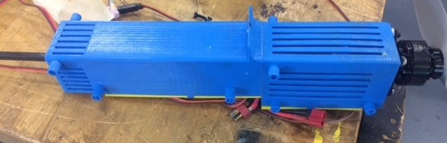
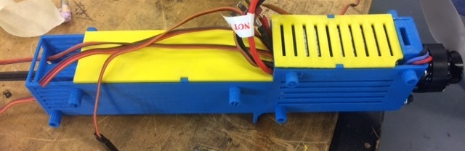
Manufacturing (Cockpit)
Cockpit includes payload bay & electronics cargo
3D printed, ABS plastic
CG aligned with center of payload bay
Slits in battery cargo reduce weight
Cockpit, top view
Cockpit, bottom view

Slide 11
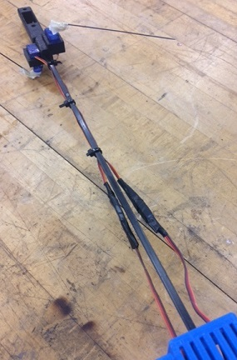
Manufacturing (Fuselage)
Two carbon fiber rods
One vertical, one horizontal to eliminate bending
Reduced rod length to align CG
Specific Design to fit in the tail and body
Carbon Fiber Rod Fuselage

Slide 12
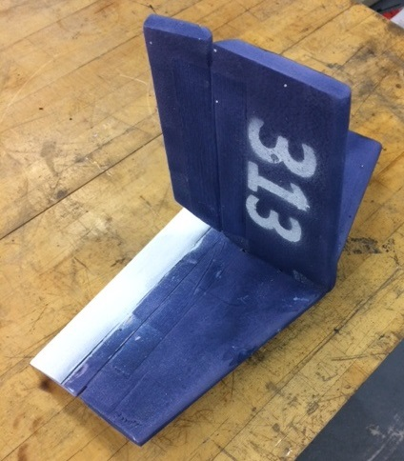
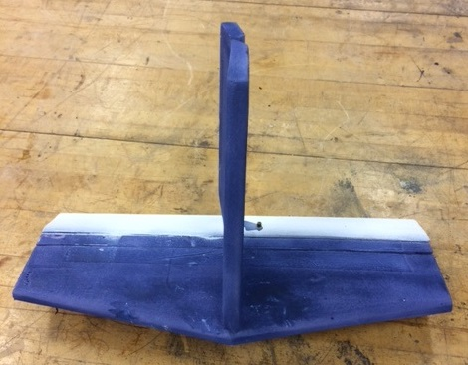
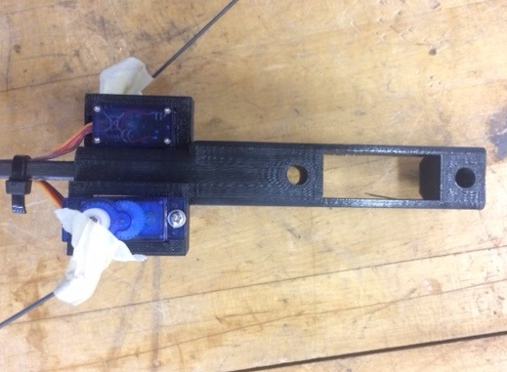
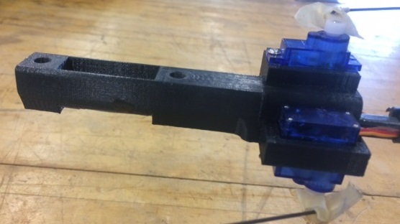
Manufacturing (tail)
Tapered shape optimizes aerodynamics
Tail mount connects tail to fuselage
Tail mount 3D printed, ABS plastic
Horizontal Stabilizer & Rudder
Tail mount, top view
Tail mount, side view

Slide 13
Manufacturing (Other)
Landing gear
Servo fitting
Propeller & mount

Slide 14
Finished Design
Picture of our design
Aspects that we like of our design
What makes our design different
Is this a winning design?
Does it stand out?

Slide 15
Flight Testing
Flight video

Slide 16
Detailed Design
Weights, stability, propulsion, aerodynamics, stress

Slide 17
Performance Prediction and Analysis
Predicted Score, Payload, Takeoff and Landing, etc

Slide 18
References
[1] "2017 Collegiate Design Series SAE Aero Design Rules“, 2017. [Online]. Available: https://www.saeaerodesign.com/content/2017_AERO_RULES_FINAL.pdf
[2] "GOE 430 AIRFOIL (goe430-il)," in Airfoil Tools, 2017. [Online]. Available: http://airfoiltools.com/airfoil/details?airfoil=goe430-il

Slide 19
Thank you

